Slide 1

SDSS: Flood Escape Arnhem
F. Bot - 1502387
E. Prentice - 4417941
C. von Delft - 4508424
16 January 2016
Notes:
EP

Slide 2
Agenda
I. Introduction
II. User Interaction
III. Data Model
IV. Analysis
V. Conclusions
Introduction | User Interaction | Data Model | Analysis | Conclusions
Notes:
EP

Slide 3
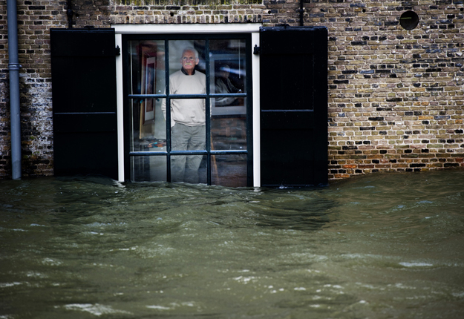
Introduction
Scenario:
flooding in Arnhem
User friendly interface
Crowd source data
Output:
Spatial Decision Support System: Emergency Response
flood extent map with routing
Introduction | User Interaction | Data Model | Analysis | Conclusions
Notes:
EP
Source: https://www.google.nl/url?sa=i&rct=j&q=&esrc=s&source=images&cd=&cad=rja&uact=8&ved=0ahUKEwjt-5n5vKnKAhVDJw8KHdcYBKEQjRwIBw&url=http%3A%2F%2Fwww.news24.com%2FMultimedia%2FWorld%2FNetherlands-floodings-20120106&psig=AFQjCNFuyp7OqGvWDKvBW1SK_ftDiKNrbA&ust=1452866784185119

Slide 4

Use Case Introduction
Jan is at work
2 daughters at school
His wife is visiting family in Ede
How to keep all safe?
Introduction | User Interaction | Data Model | Analysis | Conclusions
Notes:
CvD

Slide 5
User Interaction
General information for Jan
how city areas of Arnhem are affected by his own chosen water height?
how is the weather forecast for the upcoming dates?
how should I behave depending on the water height?
Jan’s personal situation
which water height is getting my home into danger
which POIs are still reachable?
which is my shortest path to an chosen escape city?
Introduction | User Interaction | Data Model | Analysis | Conclusions
Notes:
CvD

Slide 6
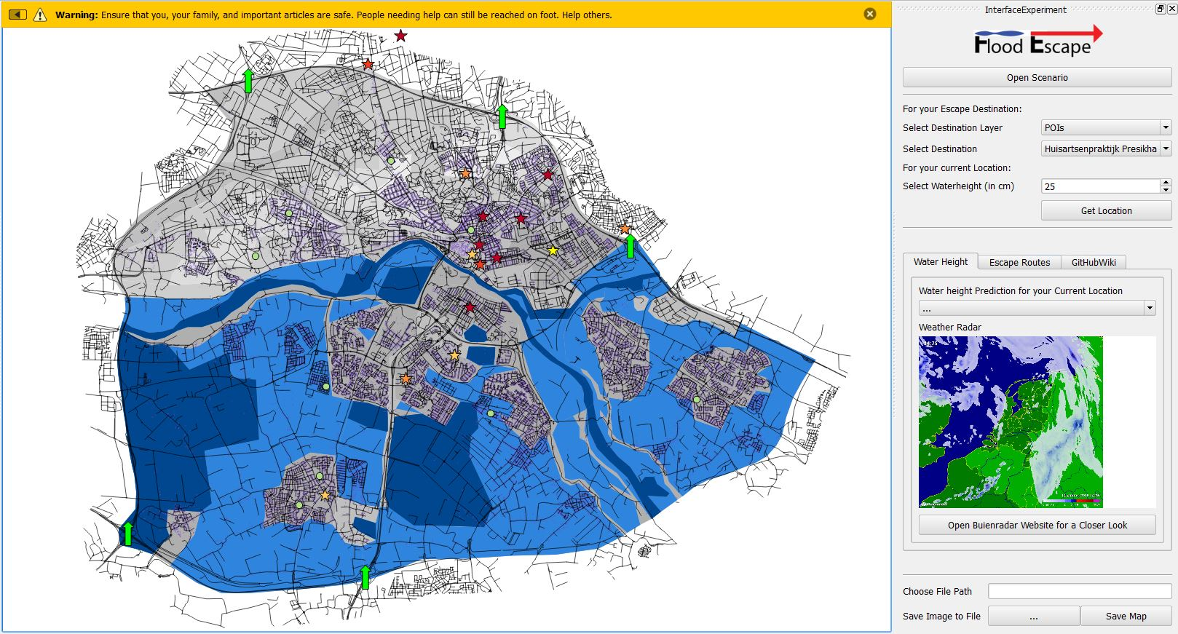
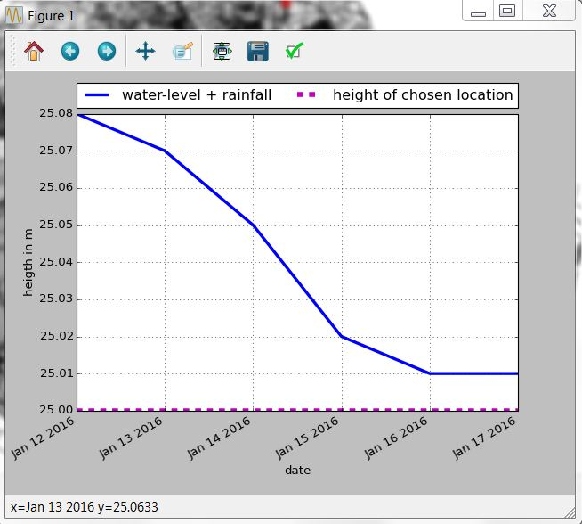

User Interaction
Introduction | User Interaction | Data Model | Analysis | Conclusions
Notes:
CvD

Slide 7
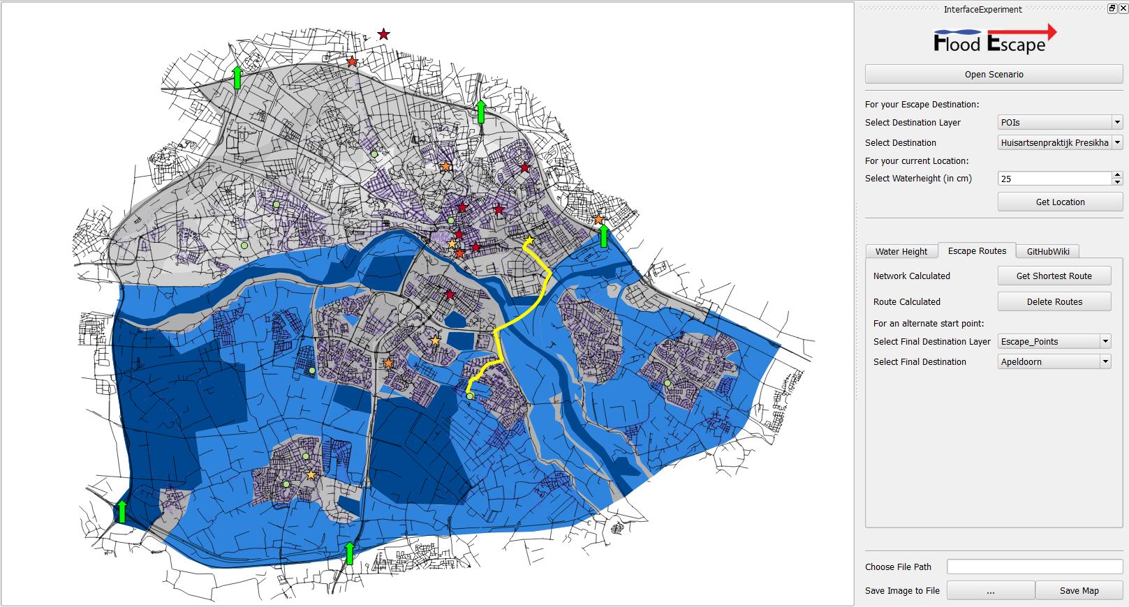
User Interaction
Introduction | User Interaction | Data Model | Analysis | Conclusions
Notes:
CvD

Slide 8

User Interaction
Introduction | User Interaction | Data Model | Analysis | Conclusions
Notes:
CvD

Slide 9
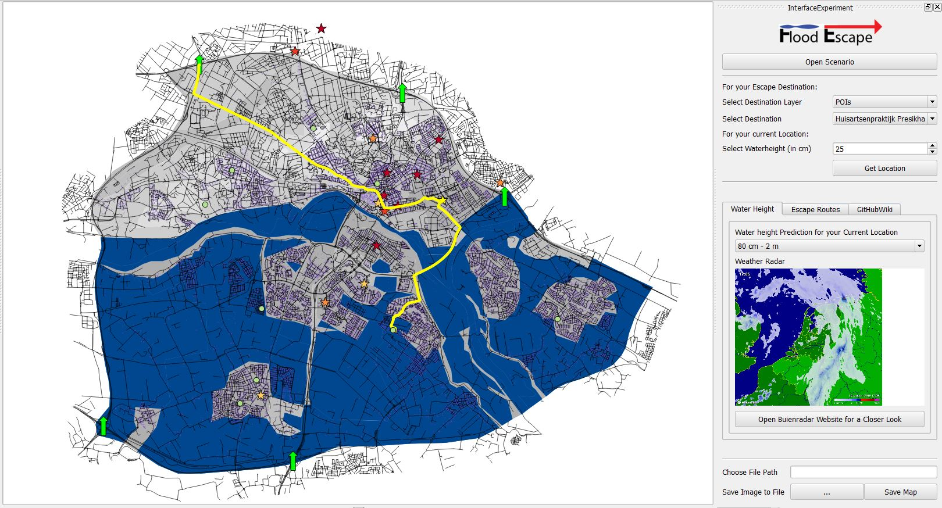
User Interaction
Introduction | User Interaction | Data Model | Analysis | Conclusions
Notes:
CvD

Slide 10

User Interaction
Results
Jan finds a safe route to pick up his girls at school
They safely evacuate to Ede together
The family is reunited!
Introduction | User Interaction | Data Model | Analysis | Conclusions
Notes:
CvD

Slide 11
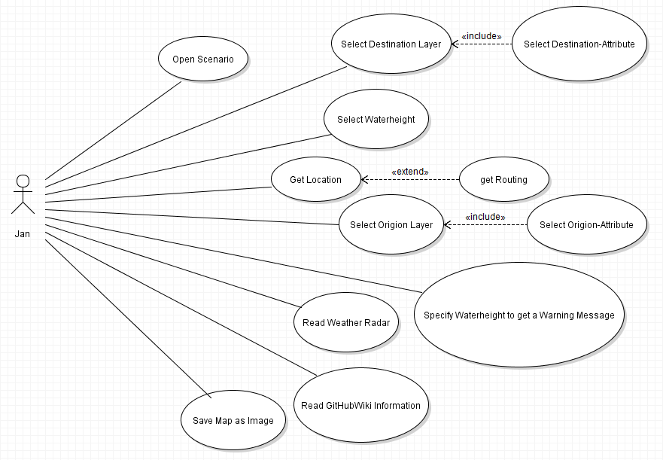
User Interaction
Introduction | User Interaction | Data Model | Analysis | Conclusions
Notes:
CvD

Slide 12
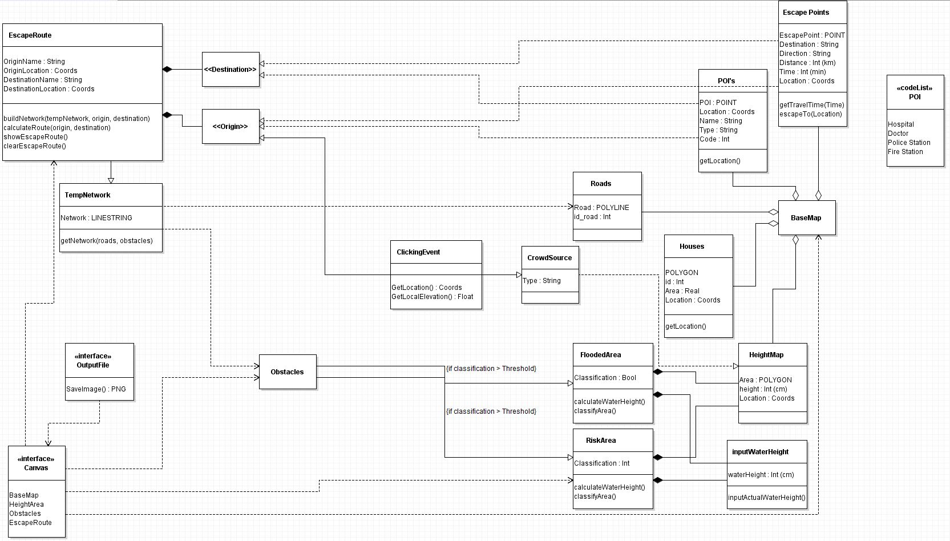
Data Model
Output
Primary Data
Introduction | User Interaction | Data Model | Analysis | Conclusions
Notes:
FB

Slide 13
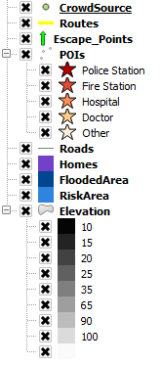
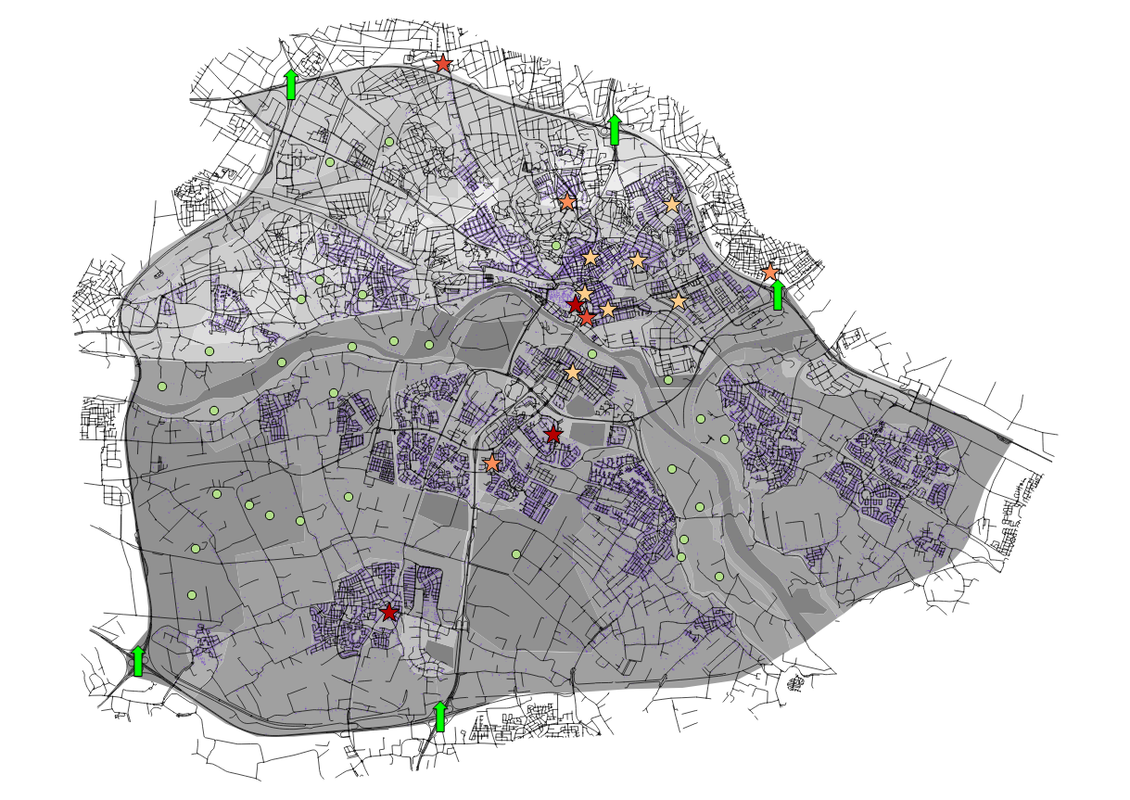
Data Model
Output
Primary Data
Introduction | User Interaction | Data Model | Analysis | Conclusions
Notes:
FB

Slide 14
Data Model
Hard Coded
Classification: flooding thresholds
Classification: prediction values
Warning messages (Dutch Standards)
Soft Coded
Point click (enables soft coding of location, water height)
Rainfall diagram (real-time data)
Combination
Routing: origins and destinations
Introduction | User Interaction | Data Model | Analysis | Conclusions
Notes:
FB – warning messages: Risicokaart.nl

Slide 15
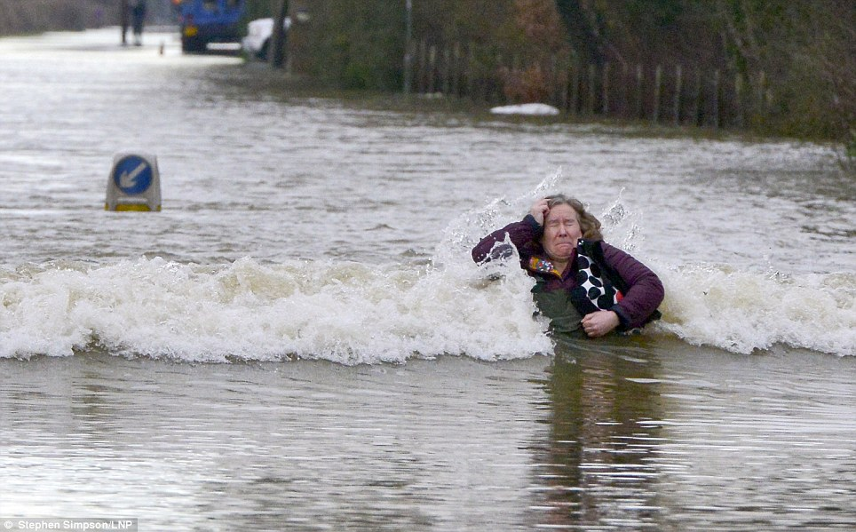
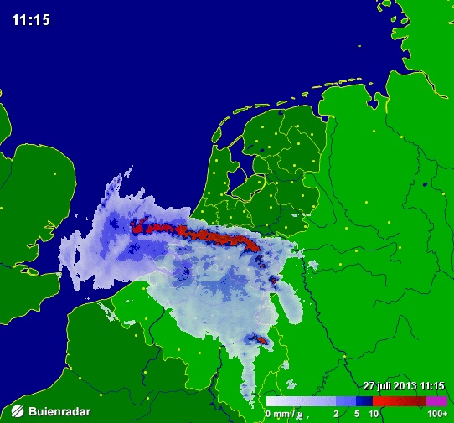
Analysis
Classification
Flood Area > 1.0 m
Risk Area > 0.5 m
Routing
Point click
POIs
Escape points
Weather forecast
Up-to-date web data rainfall diagram
Buienradar
Introduction | User Interaction | Data Model | Analysis | Conclusions
Notes:
FB

Slide 16
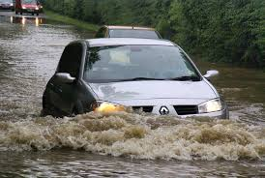
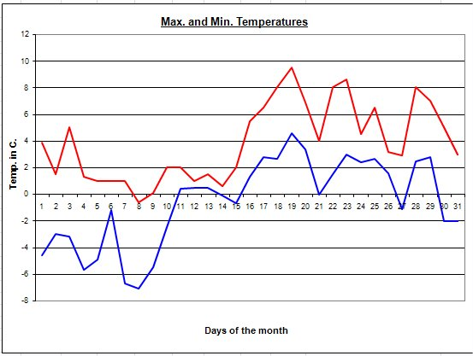
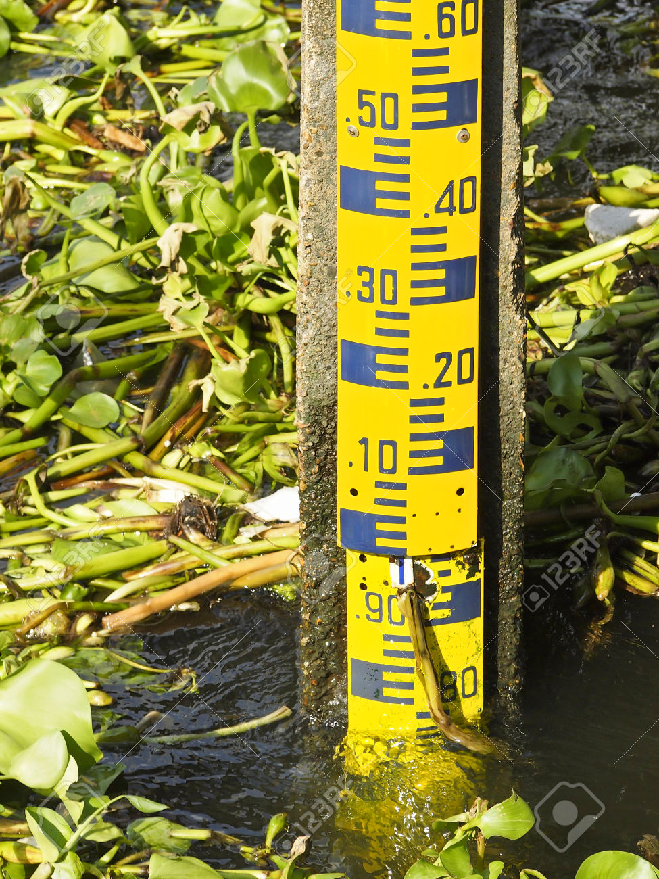

Future Enhancements
Flooded areas as routing obstacles
More detailed weather prediction
Active river level data
More precise DEM
Input personal POIs
Introduction | User Interaction | Data Model | Analysis | Conclusions
Notes:
FB

Slide 17
Conclusions
SDSS components
Information: elevation, road network, rainfall
Analysis: classification, routing
Simulation: hypothetical rainfall
Visualization: map, diagram, radar
Evaluation: flood, risk, or safe
GUI: user-friendly, efficient
Reporting: save map
Introduction | User Interaction | Data Model | Analysis | Conclusions
Notes:
EP

Slide 18
Thank you!
Questions?
Notes:
EP

Slide 19

Use Case2
Kate lives in Arnhem but is currently on vacation
The news is alarming →
Is her cat, Felix, safe at home?
Does it look like her house will flood in the next few hours?

Slide 20
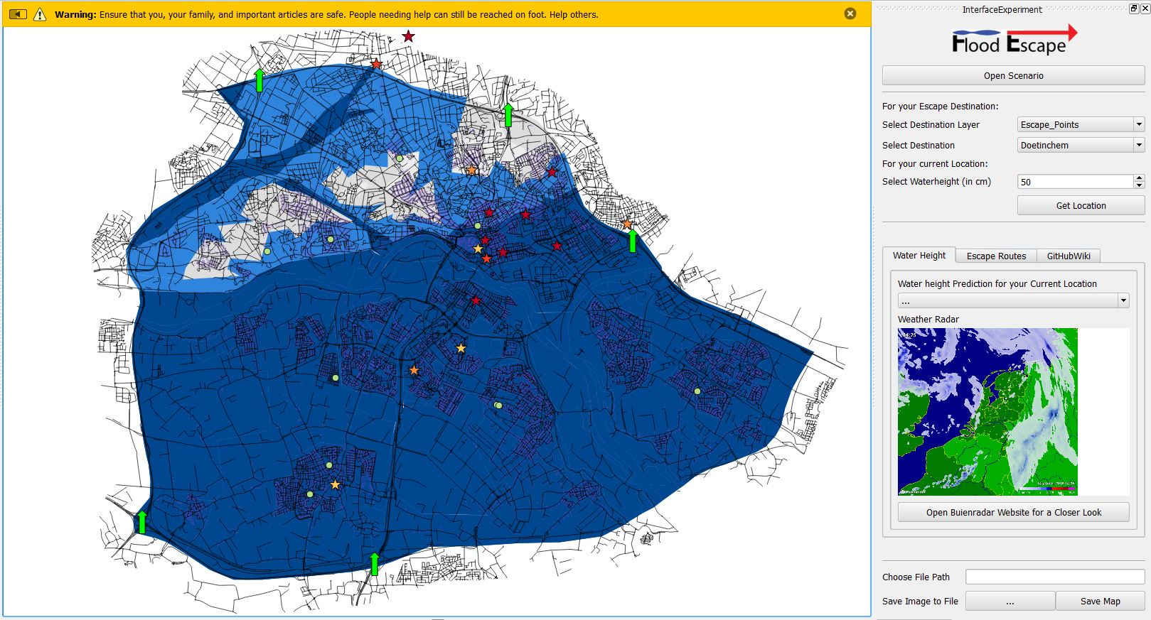
Use Case2
Flooded
Risk Area
Notes:
Kate enters 50cm based on a friend that lives close by report

Slide 21
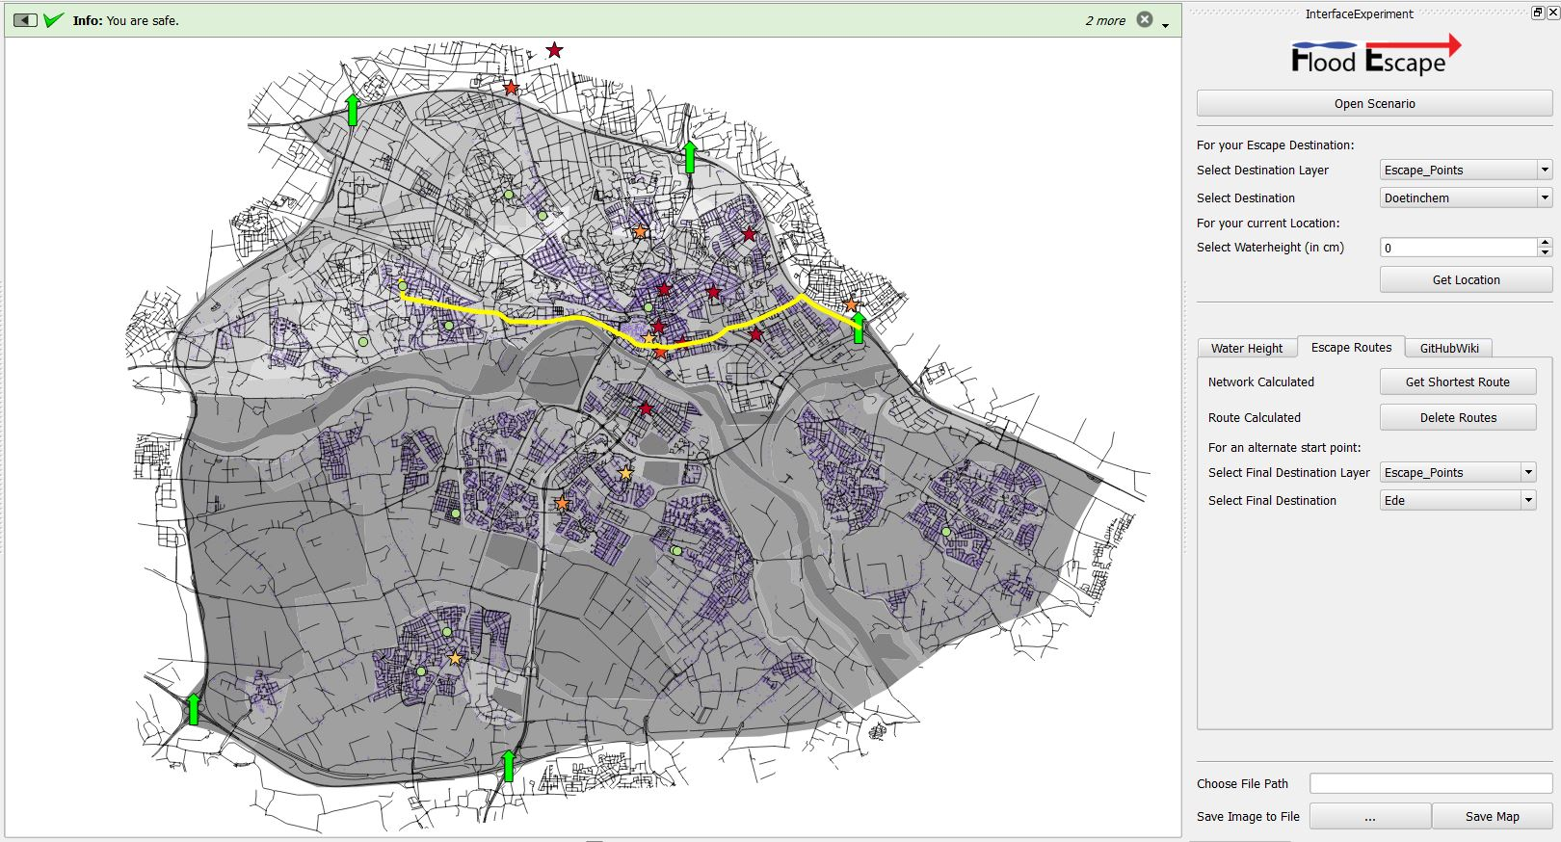
Use Case2
Notes:
Kate’s bro lives in Doetinchem where the cat needs to go- proposed route

Slide 22
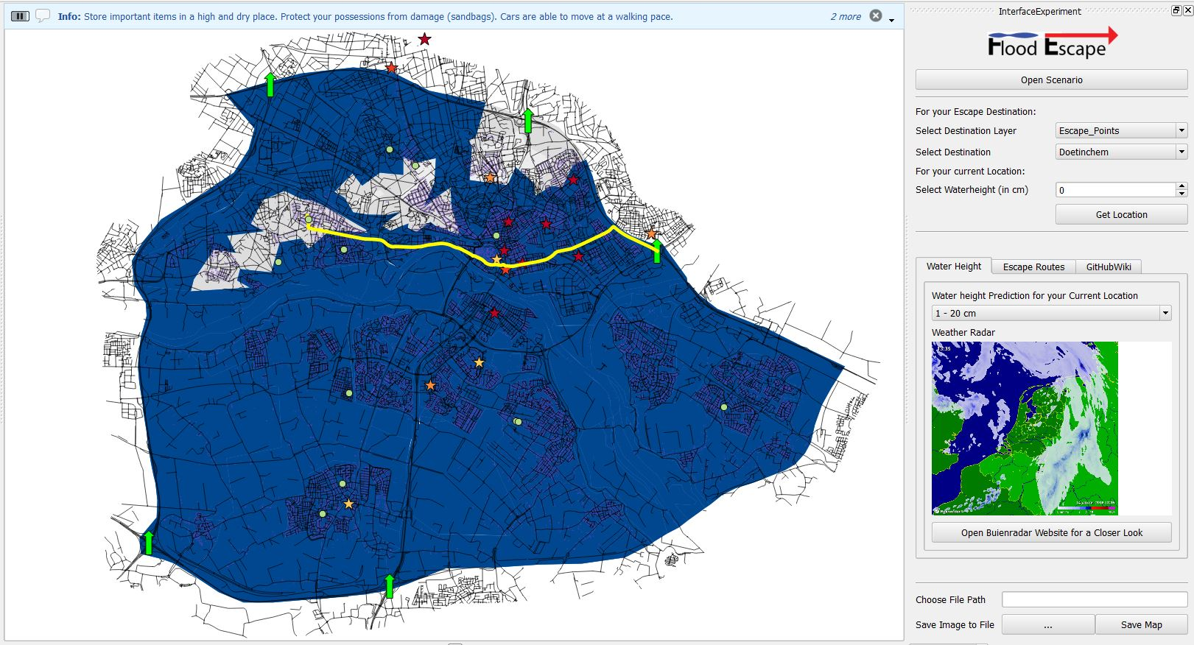
Use Case2
Flooded
Risk Area
Notes:
Predictions show 20cm increase in the next few hours but it will be flooded

Slide 23
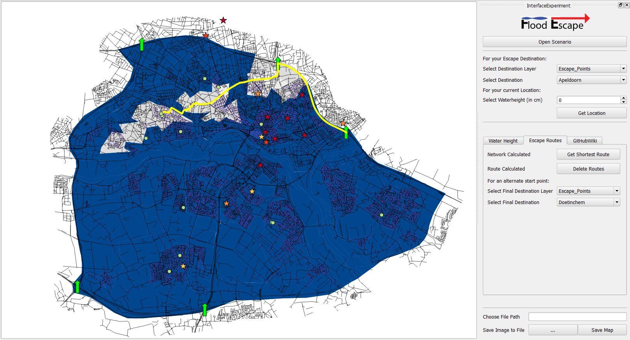
Use Case2
Flooded
Risk Area
Notes:
So re-route (Apeldoorn), friends has safest route to bro (secretly Kate’s using Felix for matchmaking)

Slide 24

Use Case2
Results
Kate’s home isn’t flooded yet but predictions show she has 3 hours
She sends a neighbor to take Felix to her brother’s house in Apeldoorn
Felix is safe!

